Slide 1
Task 2
By:
Prachi Hiware

Slide 2
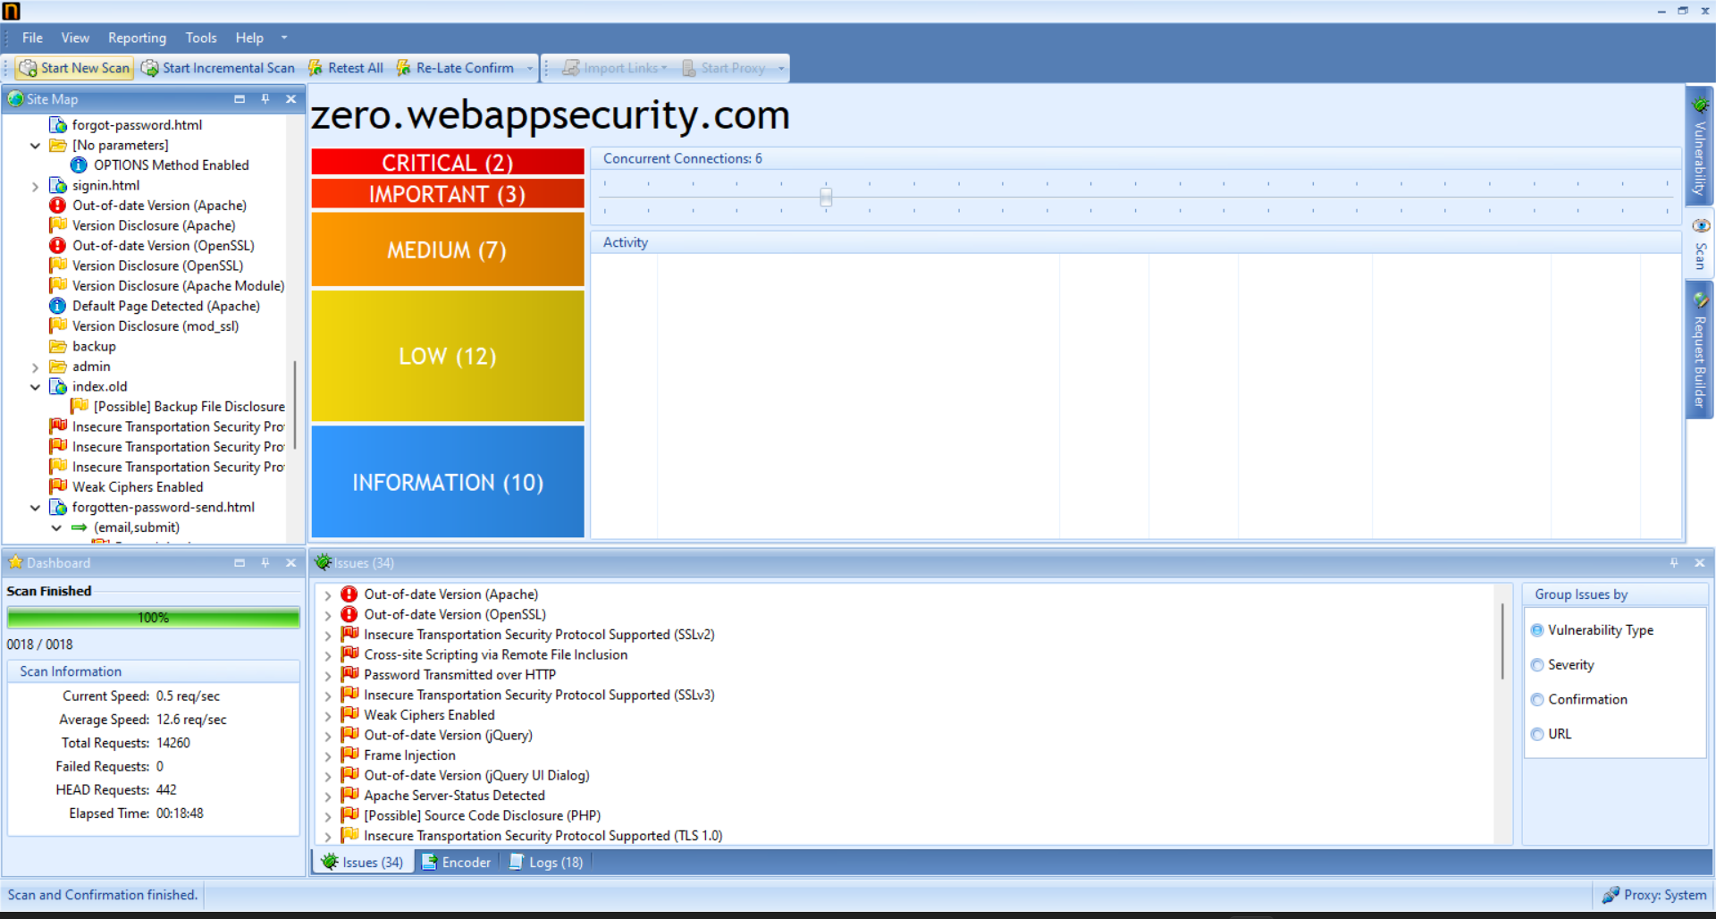
Screenshot of vulnerabilities found by Netsparker:

Slide 3
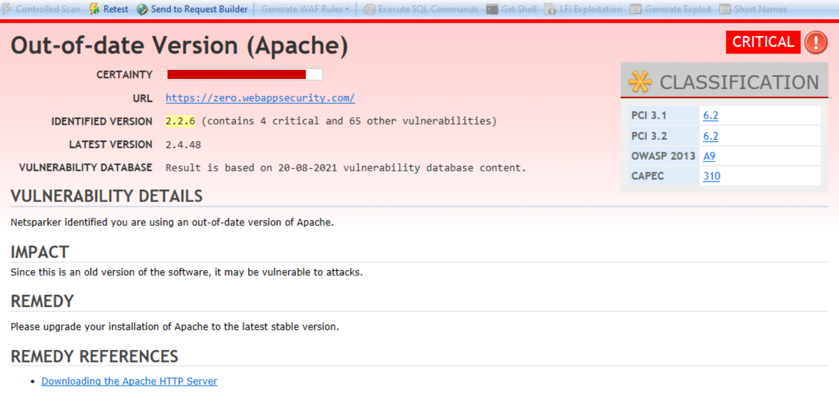
Report By Netsparker:

Slide 4
Report of Critical Vulnerability Found:
Name of vulnerability: Out-of-date Version(Apache).
Certainty: Very High.
URL: https://zero.webappsecurity.com/
Identified Version : 2.2.6
Latest Version: 2.4.48
Vulnerability Database: The findings are based on 20-08-2021 vulnerability database content.

Slide 5
1.Vulnerability Details:
Use of an out-of-date version of Apache was identified by Netsparker.
2.Impact:
This is a older version of the software ,thus it is vulnerable to attacks. Using the latest version will reduce the chances of attacks.
3.Remedy:
Upgrade the Apache installation to the latest stable version(2.4.48 as of now).
4.Remedy References:
•Downloading the Apache HTTP Server

Slide 6
5.Known Vulnerabilities in Apache version 2.2.6:
Apache HTTP Server Improper Neutralization of Input During Web Page Generation ('Cross-site Scripting') Vulnerability
Apache HTTP Server Resource Management Errors Vulnerability
Apache HTTP Server Cross-Site Request Forgery (CSRF) Vulnerability
Apache HTTP Server Improper Control of Generation of Code ('Code Injection') Vulnerability
Apache HTTP Server Improper Neutralization of Input During Web Page Generation ('Cross-site Scripting') Vulnerability
Apache HTTP Server Numeric Errors Vulnerability
Apache HTTP Server Numeric Errors Vulnerability
Apache HTTP Server Resource Management Errors Vulnerability
Apache HTTP Server Configuration Vulnerability
Apache HTTP Server Configuration Vulnerability
Apache HTTP Server Improper Neutralization of Input During Web Page Generation ('Cross-site Scripting') Vulnerability
Apache HTTP Server Exposure of Sensitive Information to an Unauthorized Actor Vulnerability
Apache HTTP Server Resource Management Errors Vulnerability
Apache HTTP Server Improper Neutralization of Input During Web Page Generation ('Cross-site Scripting') Vulnerability
Apache HTTP Server Improper Neutralization of Input During Web Page Generation ('Cross-site Scripting') Vulnerability
Apache HTTP Server Resource Management Errors Vulnerability
Apache HTTP Server Concurrent Execution using Shared Resource with Improper Synchronization ('Race Condition') Vulnerability
Apache HTTP Server Resource Management Errors Vulnerability
Apache HTTP Server Improper Input Validation Vulnerability
Apache HTTP Server DEPRECATED: Code Vulnerability
Apache HTTP Server Resource Management Errors Vulnerability

Slide 7
Apache HTTP Server Resource Management Errors Vulnerability
Apache HTTP Server Resource Management Errors Vulnerability
Apache HTTP Server Resource Management Errors Vulnerability
Apache HTTP Server Improper Input Validation Vulnerability
Apache HTTP Server Improper Input Validation Vulnerability
Apache HTTP Server Improper Input Validation Vulnerability
Apache HTTP Server Improper Input Validation Vulnerability
Apache HTTP Server Numeric Errors Vulnerability
Apache HTTP Server Resource Management Errors Vulnerability
Apache HTTP Server Other Vulnerability
Apache HTTP Server Other Vulnerability
Apache HTTP Server Other Vulnerability
Apache HTTP Server Resource Management Errors Vulnerability
Apache HTTP Server Cryptographic Issues Vulnerability
Apache HTTP Server Other Vulnerability
Apache HTTP Server Insufficient Information Vulnerability
Apache HTTP Server Exposure of Sensitive Information to an Unauthorized Actor Vulnerability
Apache HTTP Server Other Vulnerability
Apache HTTP Server Improper Input Validation Vulnerability
Apache HTTP Server Improper Input Validation Vulnerability
Apache HTTP Server Permissions, Privileges, and Access Controls Vulnerability
Apache HTTP Server Insufficient Information Vulnerability
Apache HTTP Server Insufficient Information Vulnerability
Apache HTTP Server Resource Management Errors Vulnerability
Apache HTTP Server Improper Input Validation Vulnerability

Slide 8
Apache HTTP Server Improper Input Validation Vulnerability
Apache HTTP Server Resource Management Errors Vulnerability
Apache HTTP Server Permissions, Privileges, and Access Controls Vulnerability
Apache HTTP Server Resource Management Errors Vulnerability
Apache HTTP Server Resource Management Errors Vulnerability
Apache HTTP Server Resource Management Errors Vulnerability
Apache HTTP Server Permissions, Privileges, and Access Controls Vulnerability
Apache HTTP Server Improper Neutralization of Input During Web Page Generation ('Cross-site Scripting') Vulnerability
Apache HTTP Server Improper Neutralization of Input During Web Page Generation ('Cross-site Scripting') Vulnerability
Apache HTTP Server Cryptographic Issues Vulnerability
Apache HTTP Server Permissions, Privileges, and Access Controls Vulnerability
Apache HTTP Server Permissions, Privileges, and Access Controls Vulnerability
Apache HTTP Server Improper Neutralization of Input During Web Page Generation ('Cross-site Scripting') Vulnerability
Apache HTTP Server Improper Input Validation Vulnerability
Apache HTTP Server Use After Free Vulnerability
Apache HTTP Server NULL Pointer Dereference Vulnerability
Apache HTTP Server Improper Restriction of Operations within the Bounds of a Memory Buffer Vulnerability
Apache HTTP Server Improper Restriction of Operations within the Bounds of a Memory Buffer Vulnerability
Apache HTTP Server Improper Input Validation Vulnerability
Apache HTTP Server Improper Authentication Vulnerability
Apache HTTP Server Out-of-bounds Read Vulnerability
Apache HTTP Server Improper Neutralization of CRLF Sequences ('CRLF Injection') Vulnerability
Apache HTTP Server Improper Access Control Vulnerability

